Slide 1


User Data Points gathered by Braze via SDK (or API).
SDK
SDK
Store
Intake and Aggregate Event Data
User Events and Message Engagement Events sent to Partner Storage with “Currents” – Braze managed delivery service.
1
BRAZE
Store
Send Event Data to a Data Lake
AZURE
Real-time (~5 min) Events available on Azure Storage in .avro format. Event Delivery semantics managed by Braze.
2
Onboard additional data sources and enable advanced analytics use-cases downstream.
Process Events Stream in real-time with Databricks (Auto Loader) and persist to Data Lake (downstream analysis) and Synapse (queryable and consumable).
Transform & Store in Queryable Storage
3
Use BI Tool to Manipulate / Visualize
Analyze data visually with Power BI and build Business Aligned data models and dashboards.
4

Slide 2
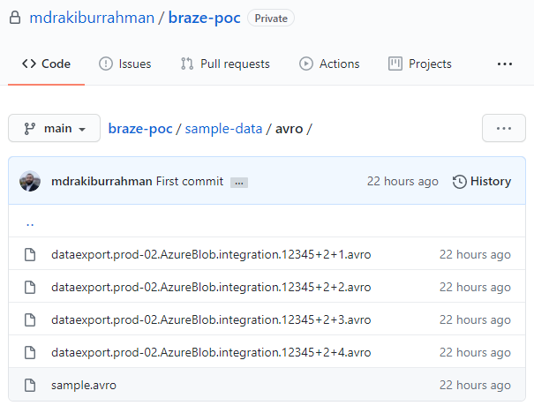
users.behaviors.Purchase
id
string
Unique id for this event
user_id
string
Braze user id of the user
app_id
string
Id for the app on which the user action occurred
time
int
UTC time of the event in seconds since the epoch
platform
string
Platform of the device (iOs, Android, Web, etc.)
os_version
string
OS Version of the device used for the action
device_model
string
Hardware model of the device
device_id
string
Id for the device on which the event occured
product_id
string
Id of the product purchased
price
float
Price of the purchase
currency
string
Three letter alpha ISO 4217 currency code
properties
string
JSON of the custom properties for this event

Slide 3
currents / dataexport.prod-02.AzureBlob.integration.12345 / event_type=users.behaviors.Purchase / date=2020-11-16-10 / 1 / A /
dataexport.prod-02.AzureBlob.integration.12345+2+1.avro
your-bucket-prefix
cluster-identifier
connection-type
integration-id
Store
Store
Store
Store
event-type
date
schema-id
zone
Store
Store
Store
Store
cluster-identifier
connection-type
integration-id
Store
Store
Store

Slide 4
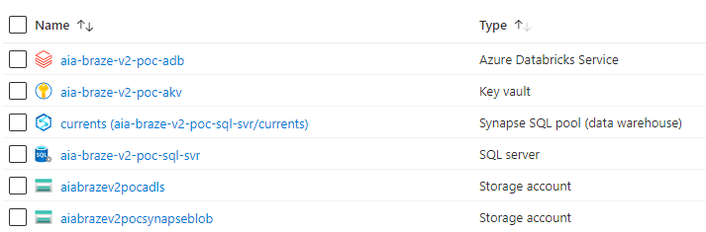
Note
Will host our Data Transformation logic
For hosting passwords/credentials
Will host ingested data in relational/queryable format
A logical server for Synapse (no functional role)
Landing zone for Braze Currents Data
A temporary staging Blob Account required for Synapse

Slide 5
currents / dataexport.prod-02.AzureBlob.integration.12345 / event_type=users.behaviors.Purchase / date=2020-11-16-10 / 1 / A /
dataexport.prod-02.AzureBlob.integration.12345+2+1.avro
Store

Slide 6
example.avro.User
user_name
string
user_score
int
user_id
string

Slide 7
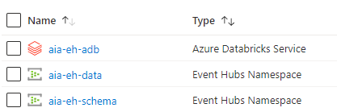
Note
Hosting Producer & Consumer applications
For sending Data to Event Hub/Topic
For registering Schema with Schema Registry

Slide 8
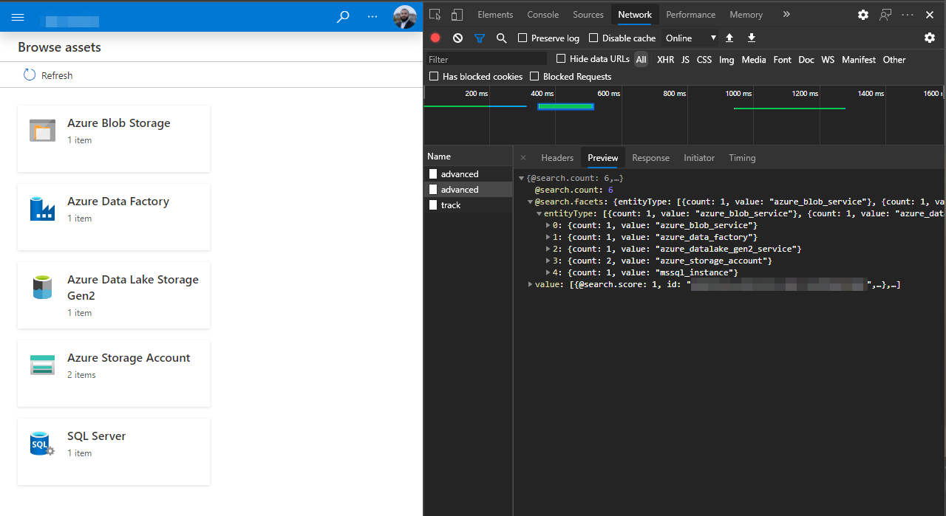


Authenticated user
API Requests
What happens
What we see

Slide 9

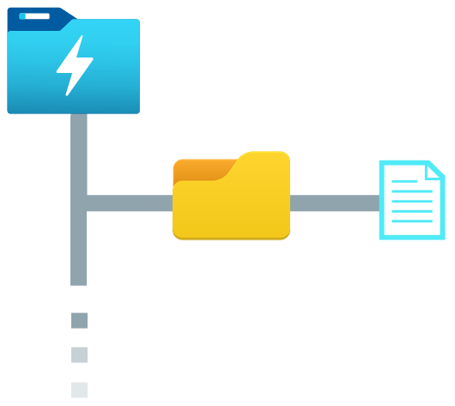


Python Script
Purview
Synapse
get-schema-purview.py
Data Lake
Column name
Classifications
filename
asset
schema
email
Email Address
CashFlow_01.csv
CashFlow_{N}.csv
0: email, PERSONAL.EMAIL
1: creditcard, FINANCIAL.CREDIT_C...
2: creditcardtype, NULL
3: amount, NULL
creditcard
Credit Card Number
REST API
CashFlow_01.csv
creditcardtype
amount
Sales_02.parquet
Sales_{N}.parquet
[["ip_address","PERSONAL.IPADDRES...
CashFlow_{N}.csv
Profit_01.json
Profit_{N}.json
"[["id",null],["IBAN",“FINANCIAL...
Spark DataFrame

Slide 10
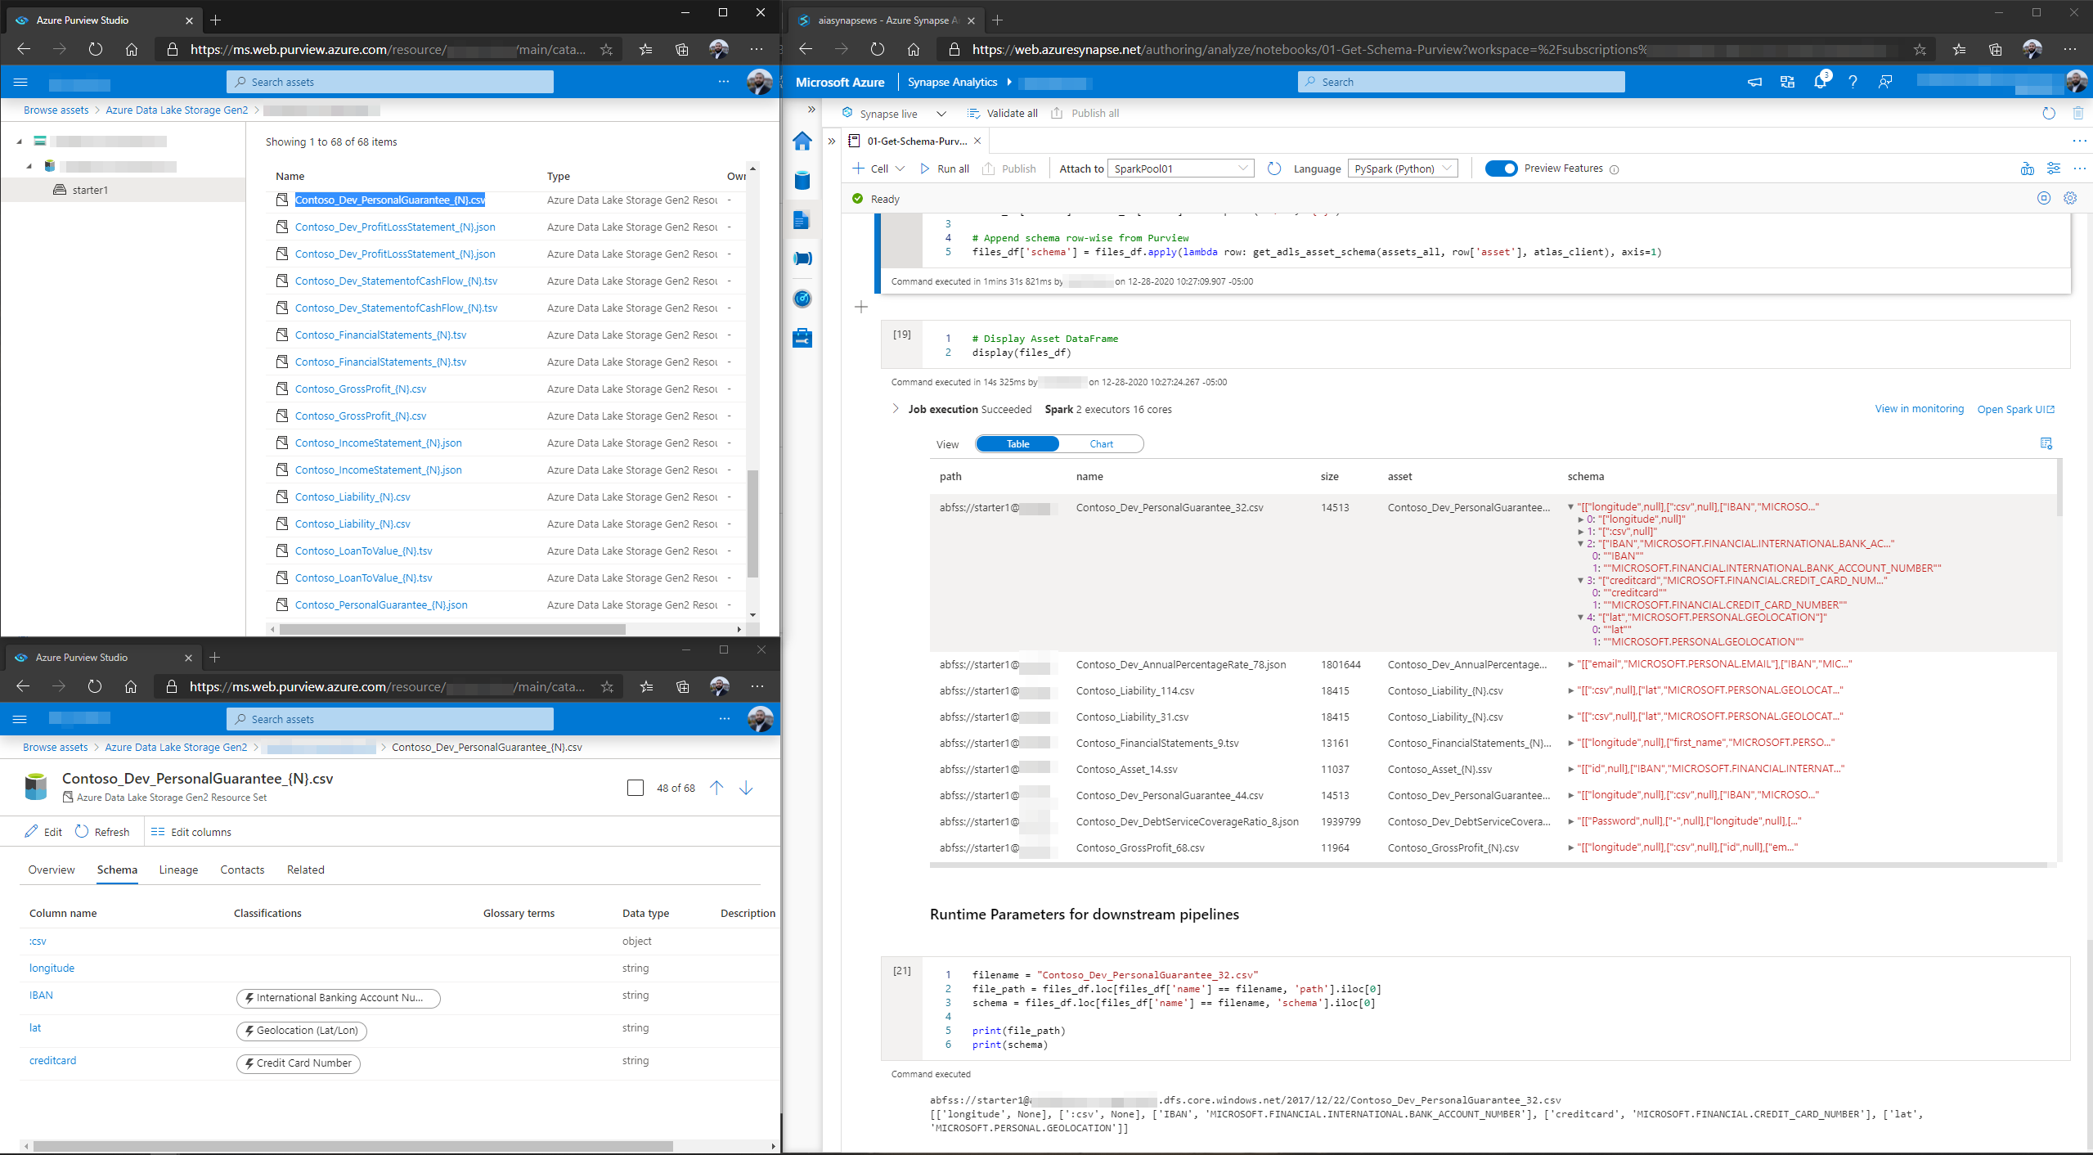

Purview
Synapse
Full asset list
Full asset list
Schema and classifications
Drill down
Drill down
Schema and classifications

Slide 11
https:// mystorageaccount.blob.core.windows.net / mycontainer / mynamespace / mytopic / 32 / 2021 / 01 / 05 / 03 / 03 / 17.avro
Storage Account
Capture Container
Store
Store
Event Hub Namespace
Event Hub Name
Partition
Year
Month
Day
Hour
Minute
Second
Store
Store
Store
Store
Store
Store
Store
Store
Store

Slide 12


Capture Schema (avro)
SequenceNumber:long
Offset:string
EnqueuedTimeUtc:string
SystemProperties:map
key:string
value:struct
member0:long
member1:double
member2:string
member3:binary
Properties:map
key:string
value:struct
member0:long
member1:double
member2:string
member3:binary
Body:binary
Our message payload (e.g. the original JSON, stored as binary)
SequenceNumber
Offset
EnqueuedTimeUtc
...
Body
0
0
1/3/2021 5:36:40 PM
...
eyJpZCI6ICJiYzllNzlhMy1lM2MyLTRlYTgtYWY1Yi00ZGRhN...
1
192
1/3/2021 5:36:40 PM
...
eyJpZCI6ICI5NTAyMzU3Mi1mNTgzLTRkM2YtYTRmMi1lNTBh...
2
384
1/3/2021 5:36:40 PM
...
eyJpZCI6ICJiMmUwNjJhNC1kYmM2LTRiYWUtYTVlOC00ZDliY...
3
576
1/3/2021 5:40:40 PM
...
eyJpZCI6ICI1OWQ0YzY0OS0wODNmLTQ0MDUtODhhYi1lOWVm...
4
768
1/3/2021 5:40:40 PM
...
eyJpZCI6ICI4NWIwMTlkZi03ZjdmLTRmMzEtOGJjNi0zYmRj...
avro
JSON (can be avro, csv etc.)
1
Capture Schema
2
Payload Schema

Slide 13
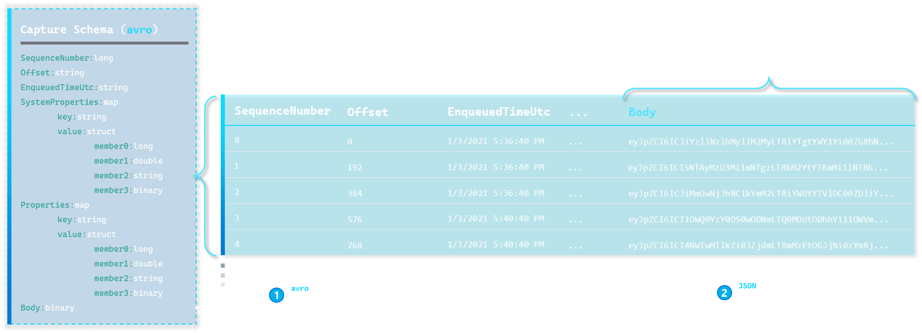

Slide 14
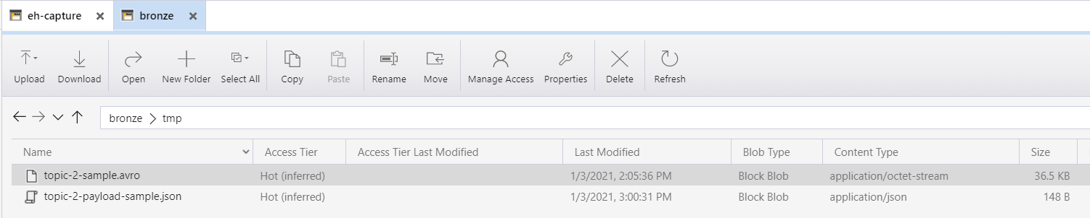

Data Lake
1
2
avro
1
Capture Schema
JSON (can be avro, csv etc.)
2
Payload Schema

Slide 15
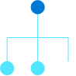
BEFORE
AFTER
Custom application
Read/Write
Read/Write
Load Balancer
Read-Scale
SQL Server
SQL Server
Replication mechanism
On-Prem
On-Prem
Azure
Analytics

Slide 16









Latency
Data Flow
On-prem
Data Factory
Azure SQL
ETL tool
1
varies by trigger
SQL Server
Integration Runtime
SQL DB
SQL MI
Build a custom pipeline with Azure Data Factory.
Azure SQL Data Sync
On-prem
SQL Data Sync
Azure SQL
2
5 min minimum
SQL Server
Sync Agent
Sync App
Sync DB
SQL DB
An Azure managed Web-Service with bi-directional sync capabilities to Azure SQL DB – no MI support yet.
Publisher & Distributor
Subscriber
SQL Server Replication
On-Prem SQL Server
Replication agents
SQL DB
SQL MI
3
Uses SQL Replication Engine (transactionally consistent). 6 types available (choice differs for SQL DB or MI)
~seconds
Publication
Subscription
On-prem
Backups
Azure SQL
Database Migration Service
SQL Server
SMB Folder
DMS Agent
DMS Service
4
log backup frequency
.bak,.trn
Blob Storage
SQL DB
SQL MI
Uses log-shipping of Full (.bak) and Trx (.trn) log backups to continuously ship and apply with the “online” option.
3rd Party Products
And more...
5
varies by product
Number of 3rd Party tools exist in the market – YMMV.
Other hands-on, custom options exist, include SQL Server Service Broker (place writes on queue and send over), and Azure Event Hub (use as a message queue), and permutations thereof.

Slide 17
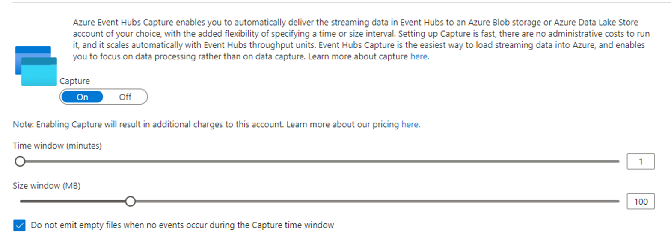
Defines our KQL pathformat

Slide 18
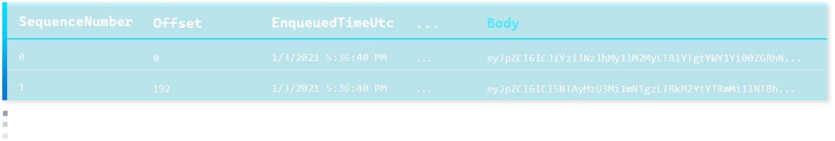

Remains static
.create external table aiaehdatacapture (SequenceNumber:long,
Offset:string,
EnqueuedTimeUtc:string,
SystemProperties:dynamic,
Properties:dynamic,
Body: dynamic)
kind=adl
partition by (EHPartition:string, Capture_timestamp:datetime)
pathformat = (EHPartition "/" datetime_pattern("yyyy/MM/dd/HH/mm", Capture_timestamp))
dataformat=apacheavro
(
h@'abfss://<your--container>@<your--adls>.dfs.core.windows.net/<your--eh--namespace>/<your--eh>;<your--storage--account--key>'
)
event hub capture schema
capture frequency
filetype

Slide 19
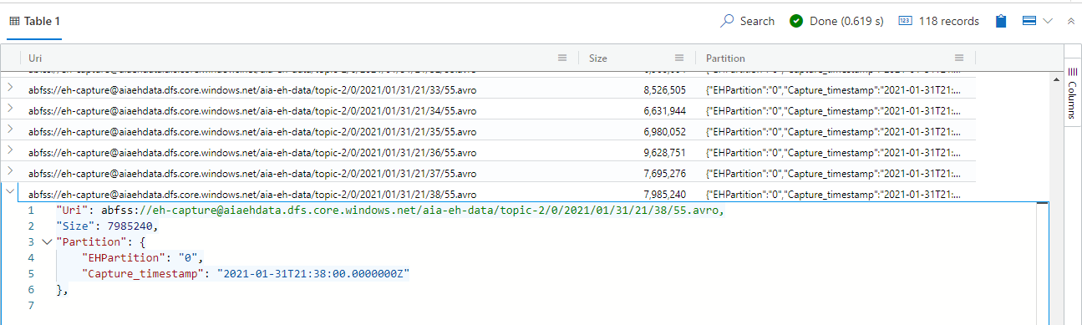
Inferred Partitions

Slide 20
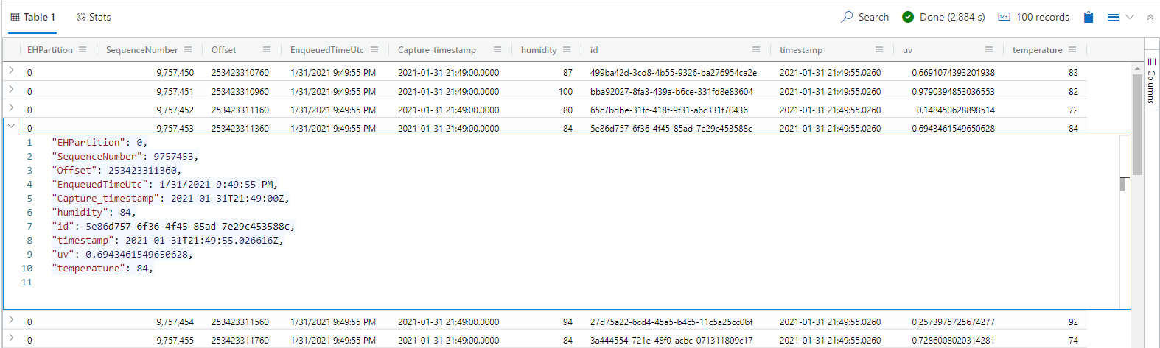
Exploded JSON payload

Slide 21
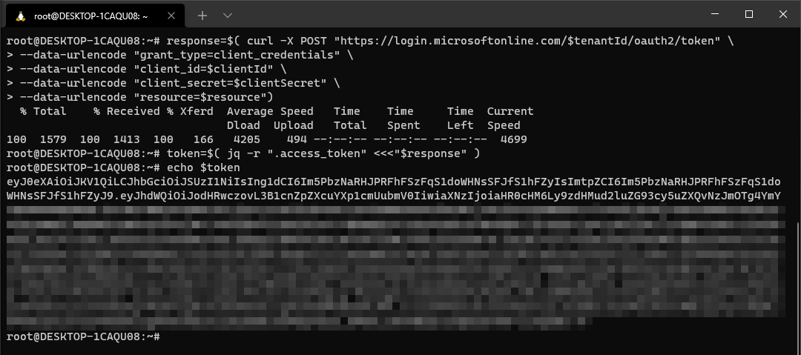
Get OAuth Token

Slide 22
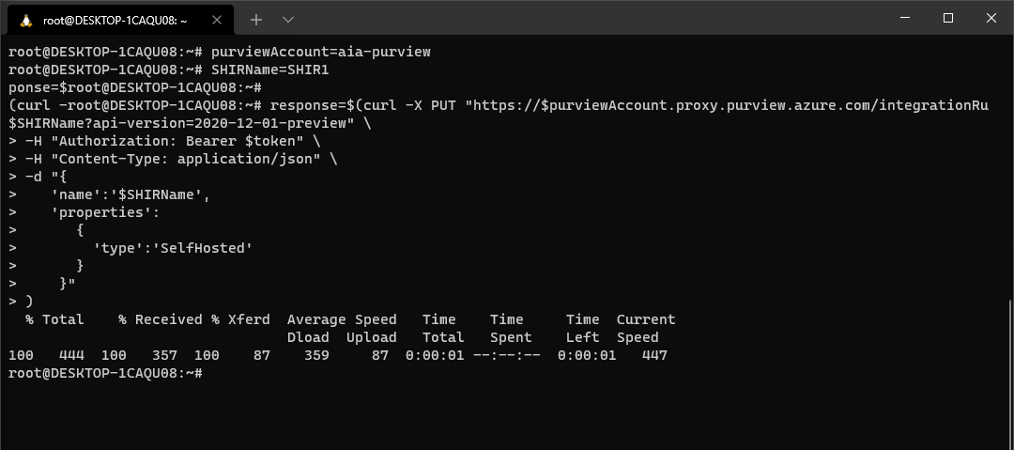
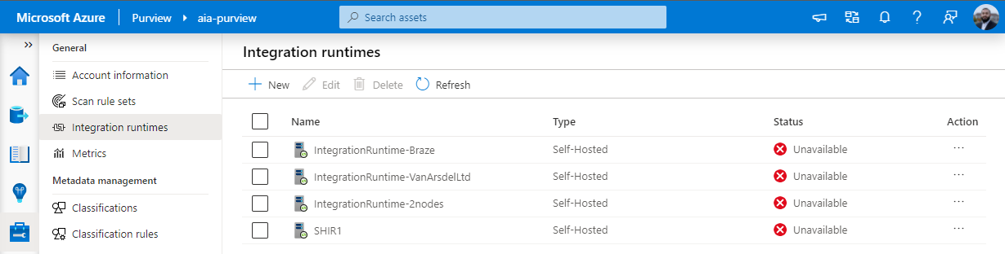

Create SHIR1

Slide 23
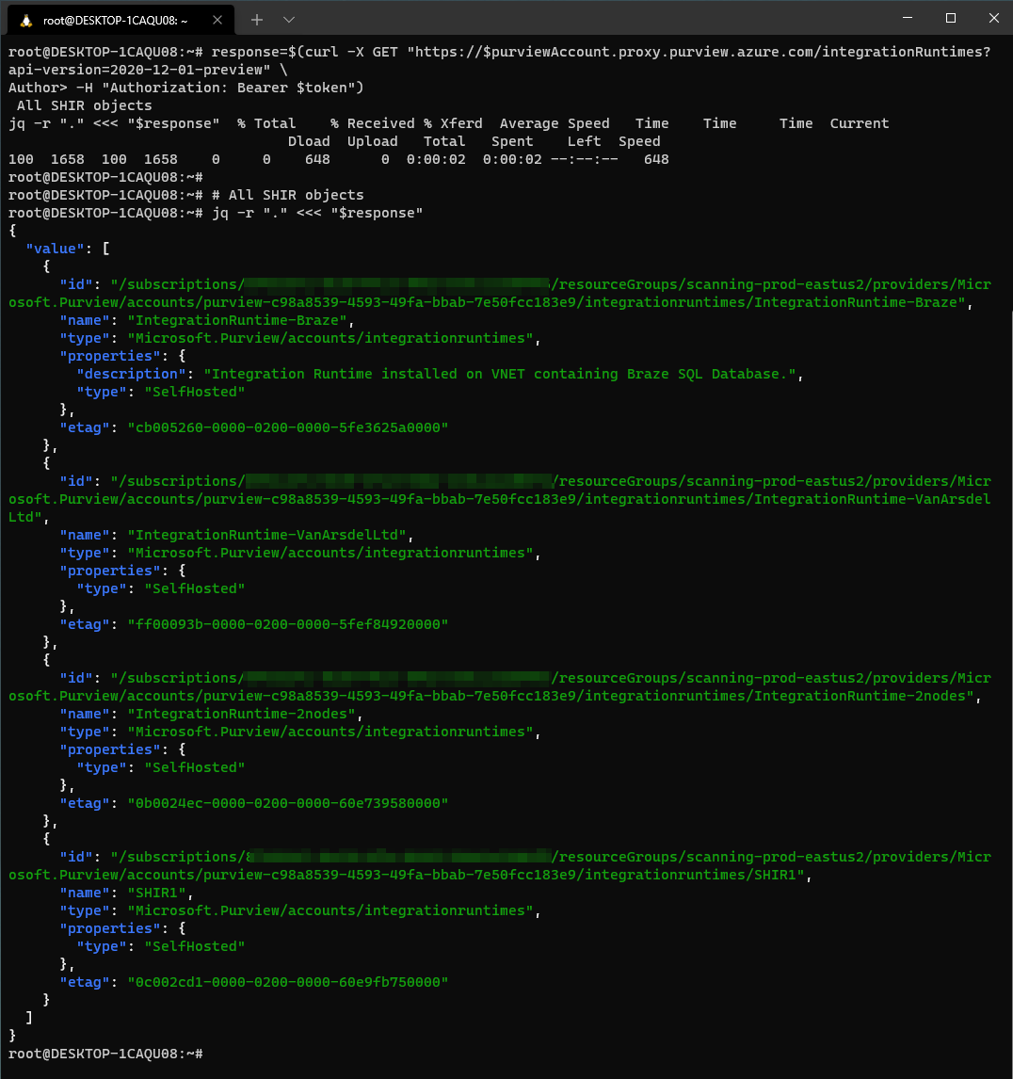
All SHIRs

Slide 24
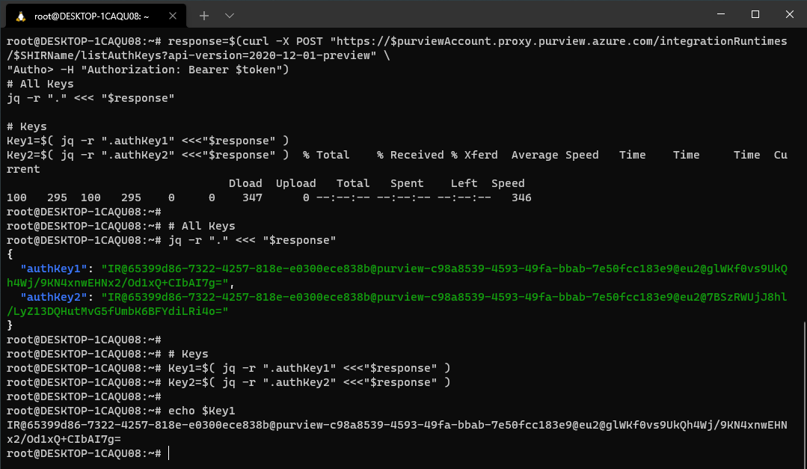
SHIR Keys

Slide 25
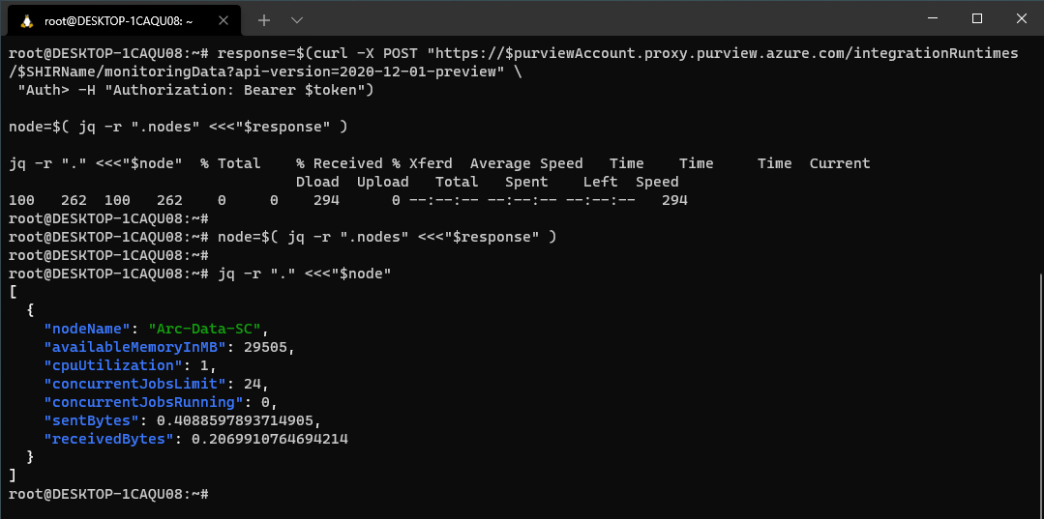
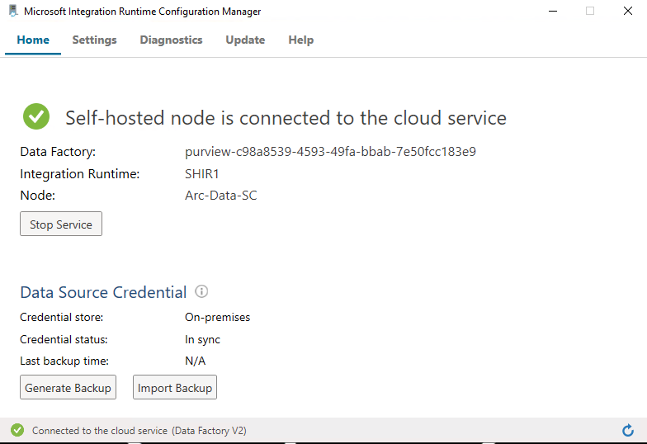
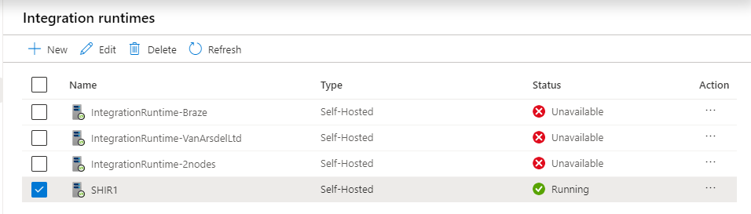
VM2
Within VM2
Within Purview Studio

Slide 26
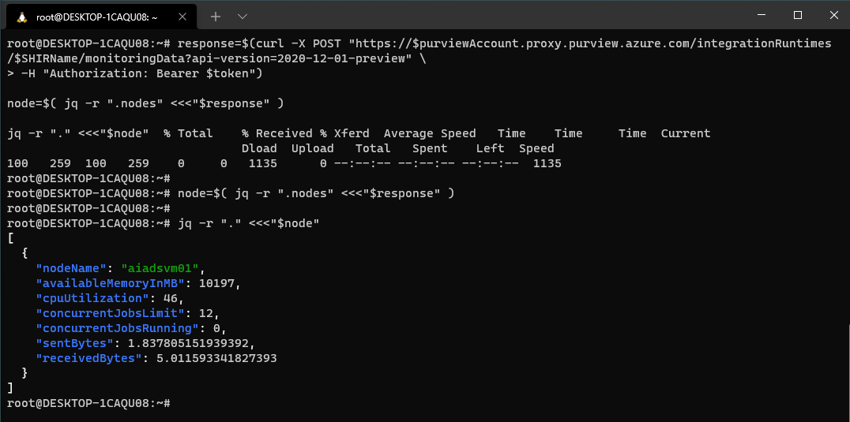
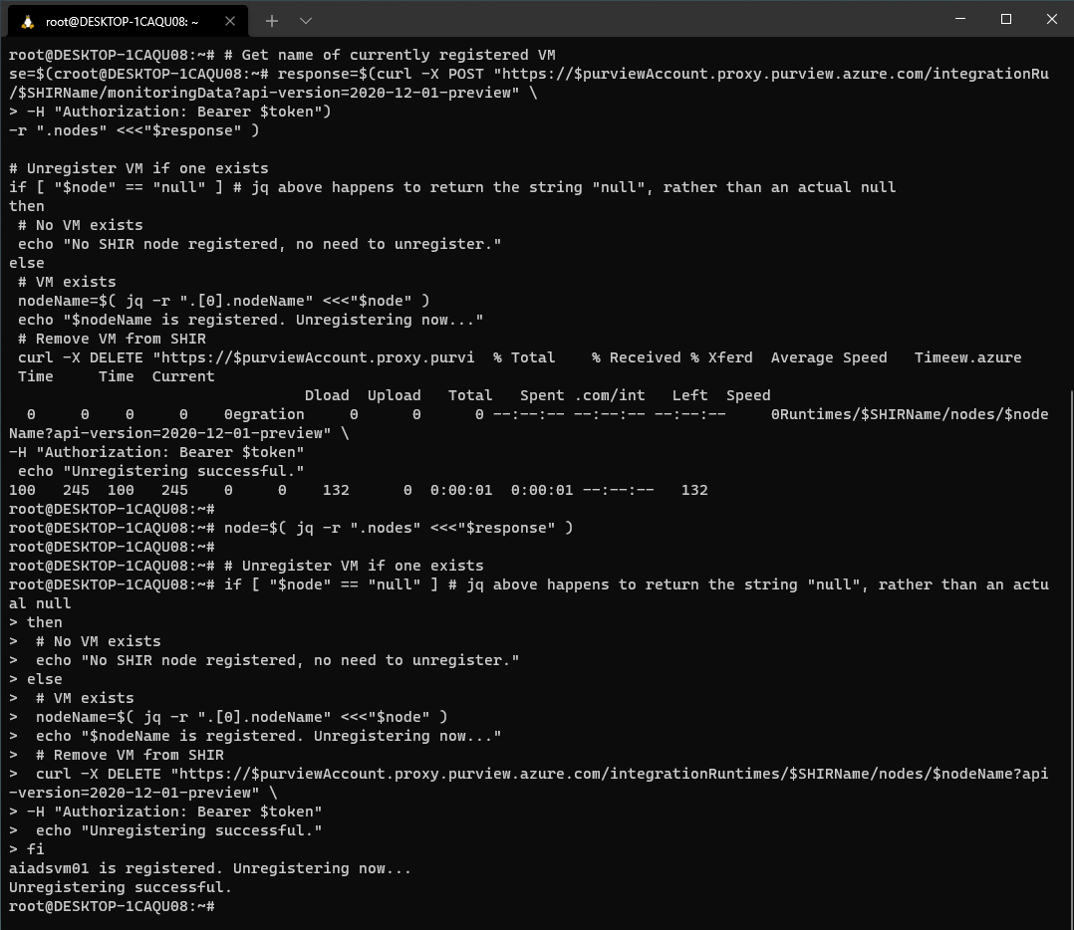
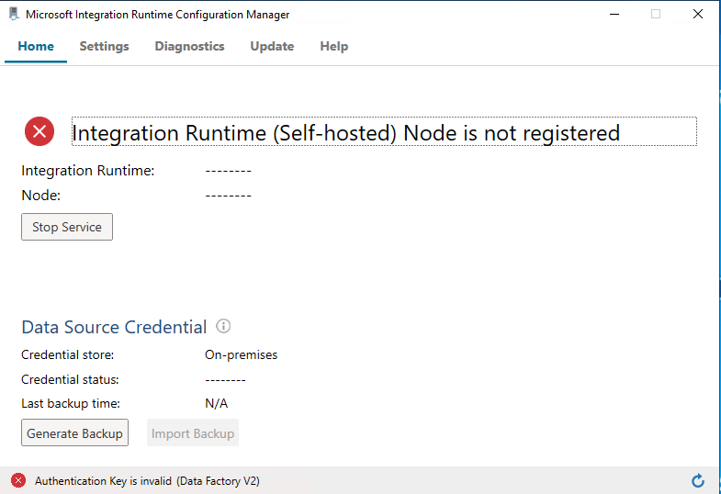
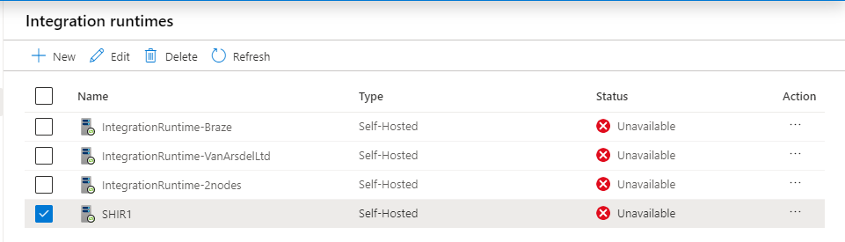
Unregisters VM1
Within VM1
Within Purview Studio
Since VM1 is unregistered

Slide 27
SHIR Keys

Slide 28
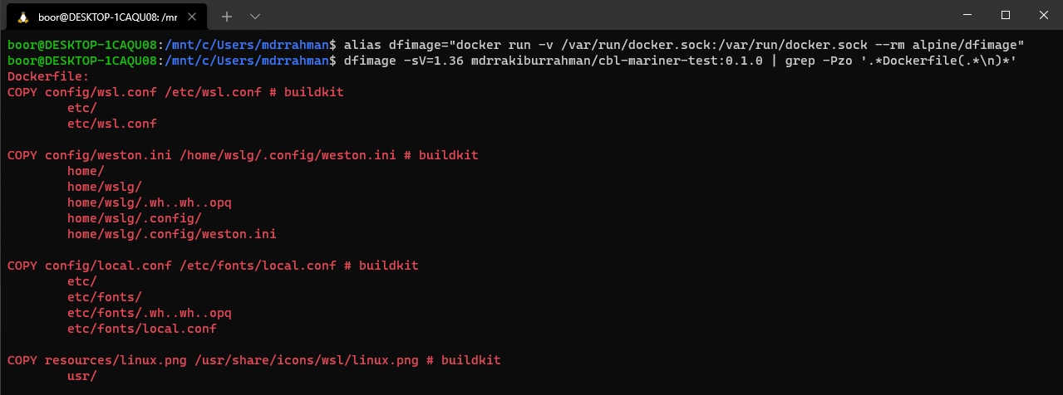
Original
Dockerfile

Slide 29
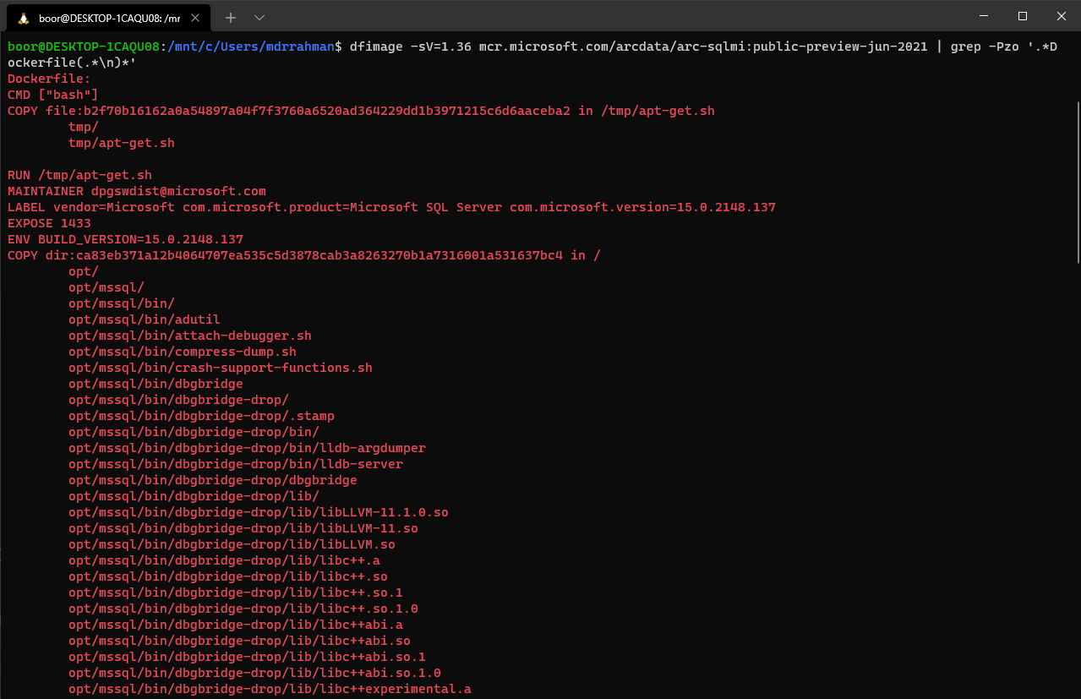
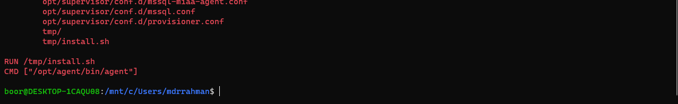
Reverse Engineered
Dockerfile
for arc-sqlmi:
Omitted for brevity

Slide 30
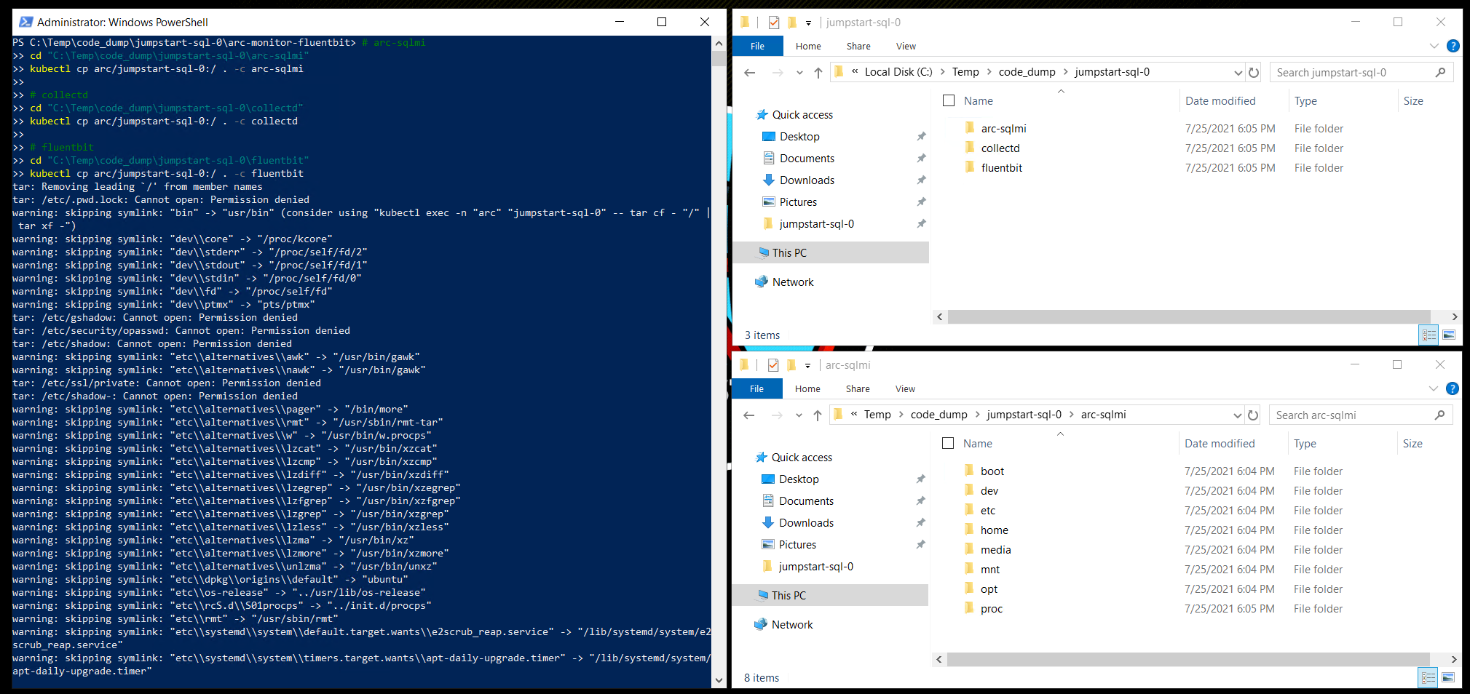
kubectl cp src dest
3 containers in SQL MI

Slide 31
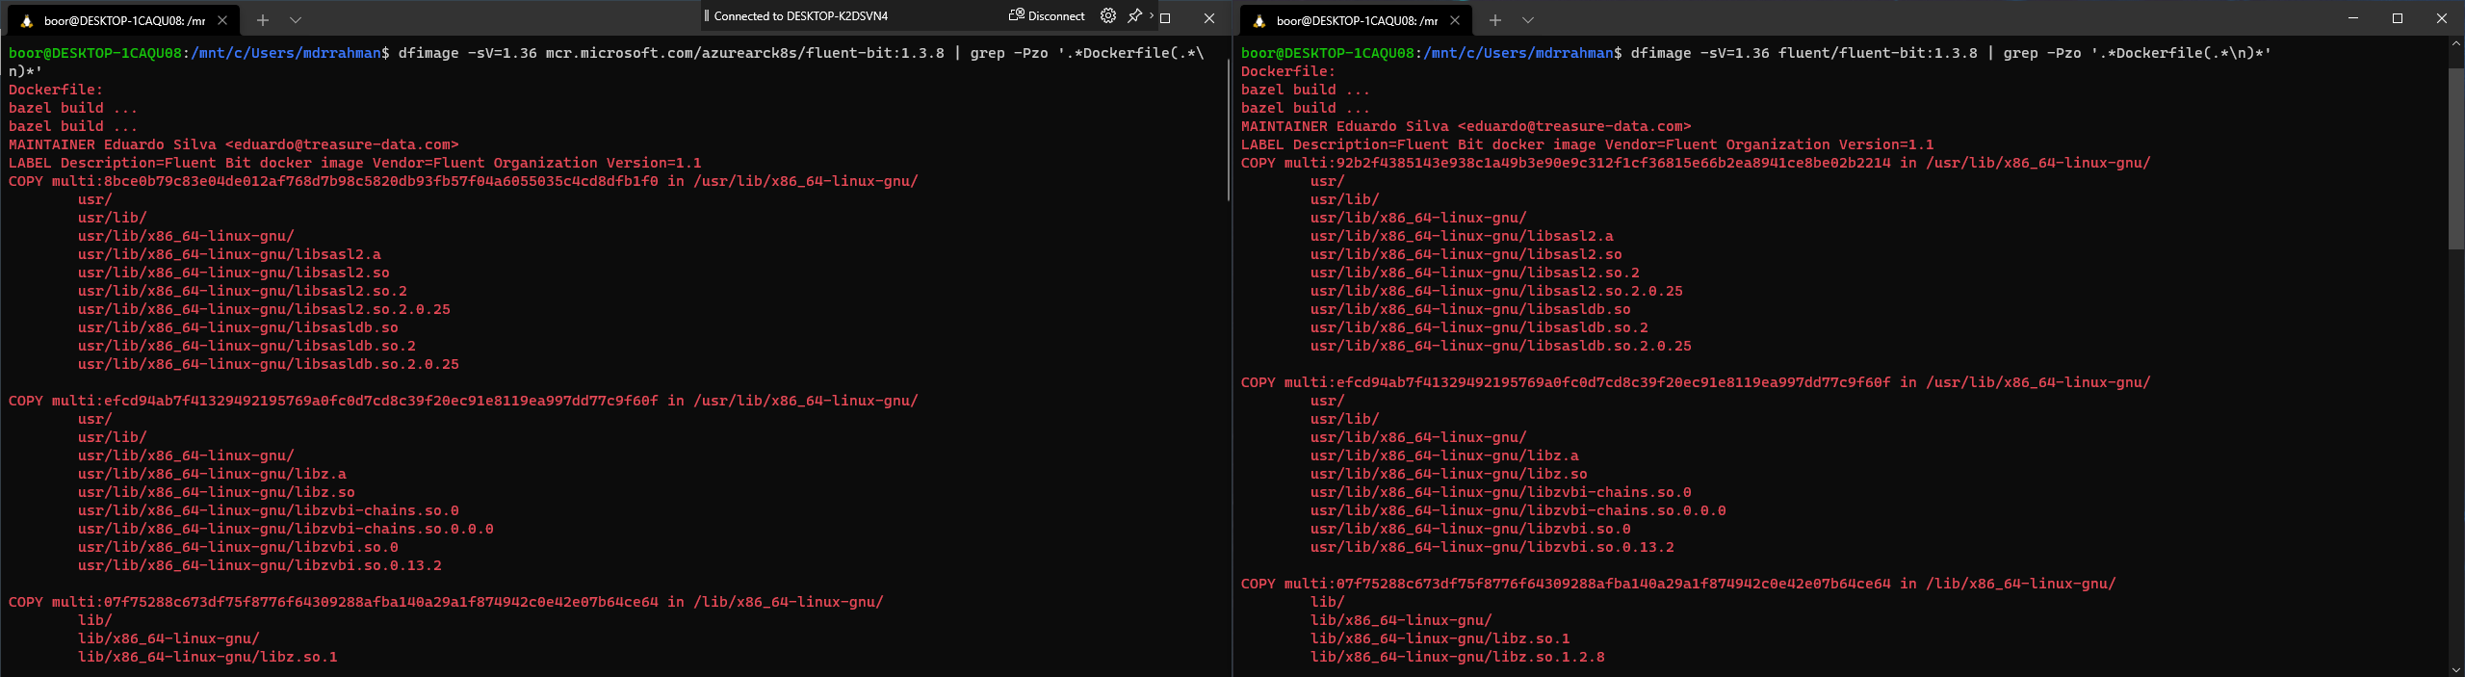
mcr.microsoft.com/azurearck8s/fluent-bit:1.3.8
fluent/fluent-bit:1.3.8
Both reverse Engineered Dockerfiles are fairly identical (which makes sense, they’re both fluent-bit 1.3.8)

Slide 32
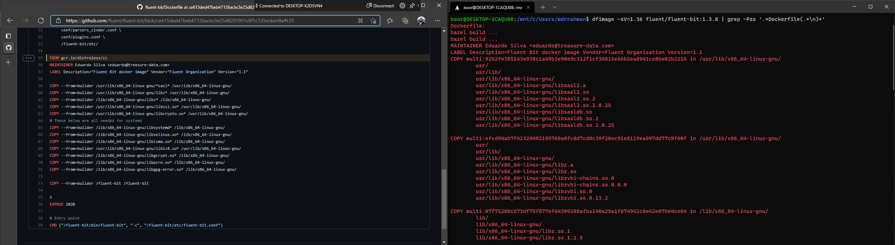
fluent-bit:1.3.8 original Dockerfile
fluent/fluent-bit:1.3.8
gcr.io/distroless/cc base image
Dockerfiles are identical – with added steps for base image gcr.io/distroless/cc

Slide 33


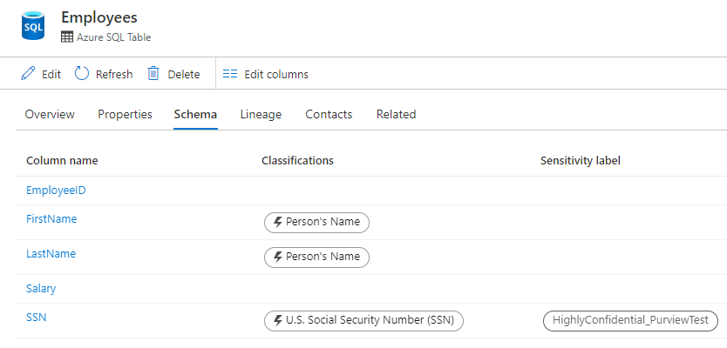


Purview
1
Azure SQL DB
Authorized DBA
Column Level Encryption
Decrypts sensitive data to plaintext
Scan everyday at 12 PM
2
4
Found Sensitive Assets
Kafdrop
3
Atlas Hook
Read topic
Custom Microservice
ENTITY_UPDATE CLASSIFICATION_ADD …
Spark Streaming
Streaming App
Webhook of some sort
Kafka endpoint (Managed Purview)
5

Slide 34




multipass
Keytab For Kerberos
AD Creds
create-sql-keytab.sh
yaml
6
a
dc Domain Controller + DNS Server
client Demo VM with SSMS etc.
CONTOSO\first.last WIndows Authenticated user
2
5
3
9
aks-cni AKS with Azure CNI Networking
contoso.local
sql-ad-yes-1.contoso.local,31443 20.62.137.14,31433
1
DNS Proxy Running CoreDNS
sql-ad-yes-1 SQL MI + AD integration
7
8
... Other MIs
Data Controller Automates keytab injection etc.
4
DNS
Job
AD Creds
Secrets
6
b
Keytab
Keytab

Slide 35
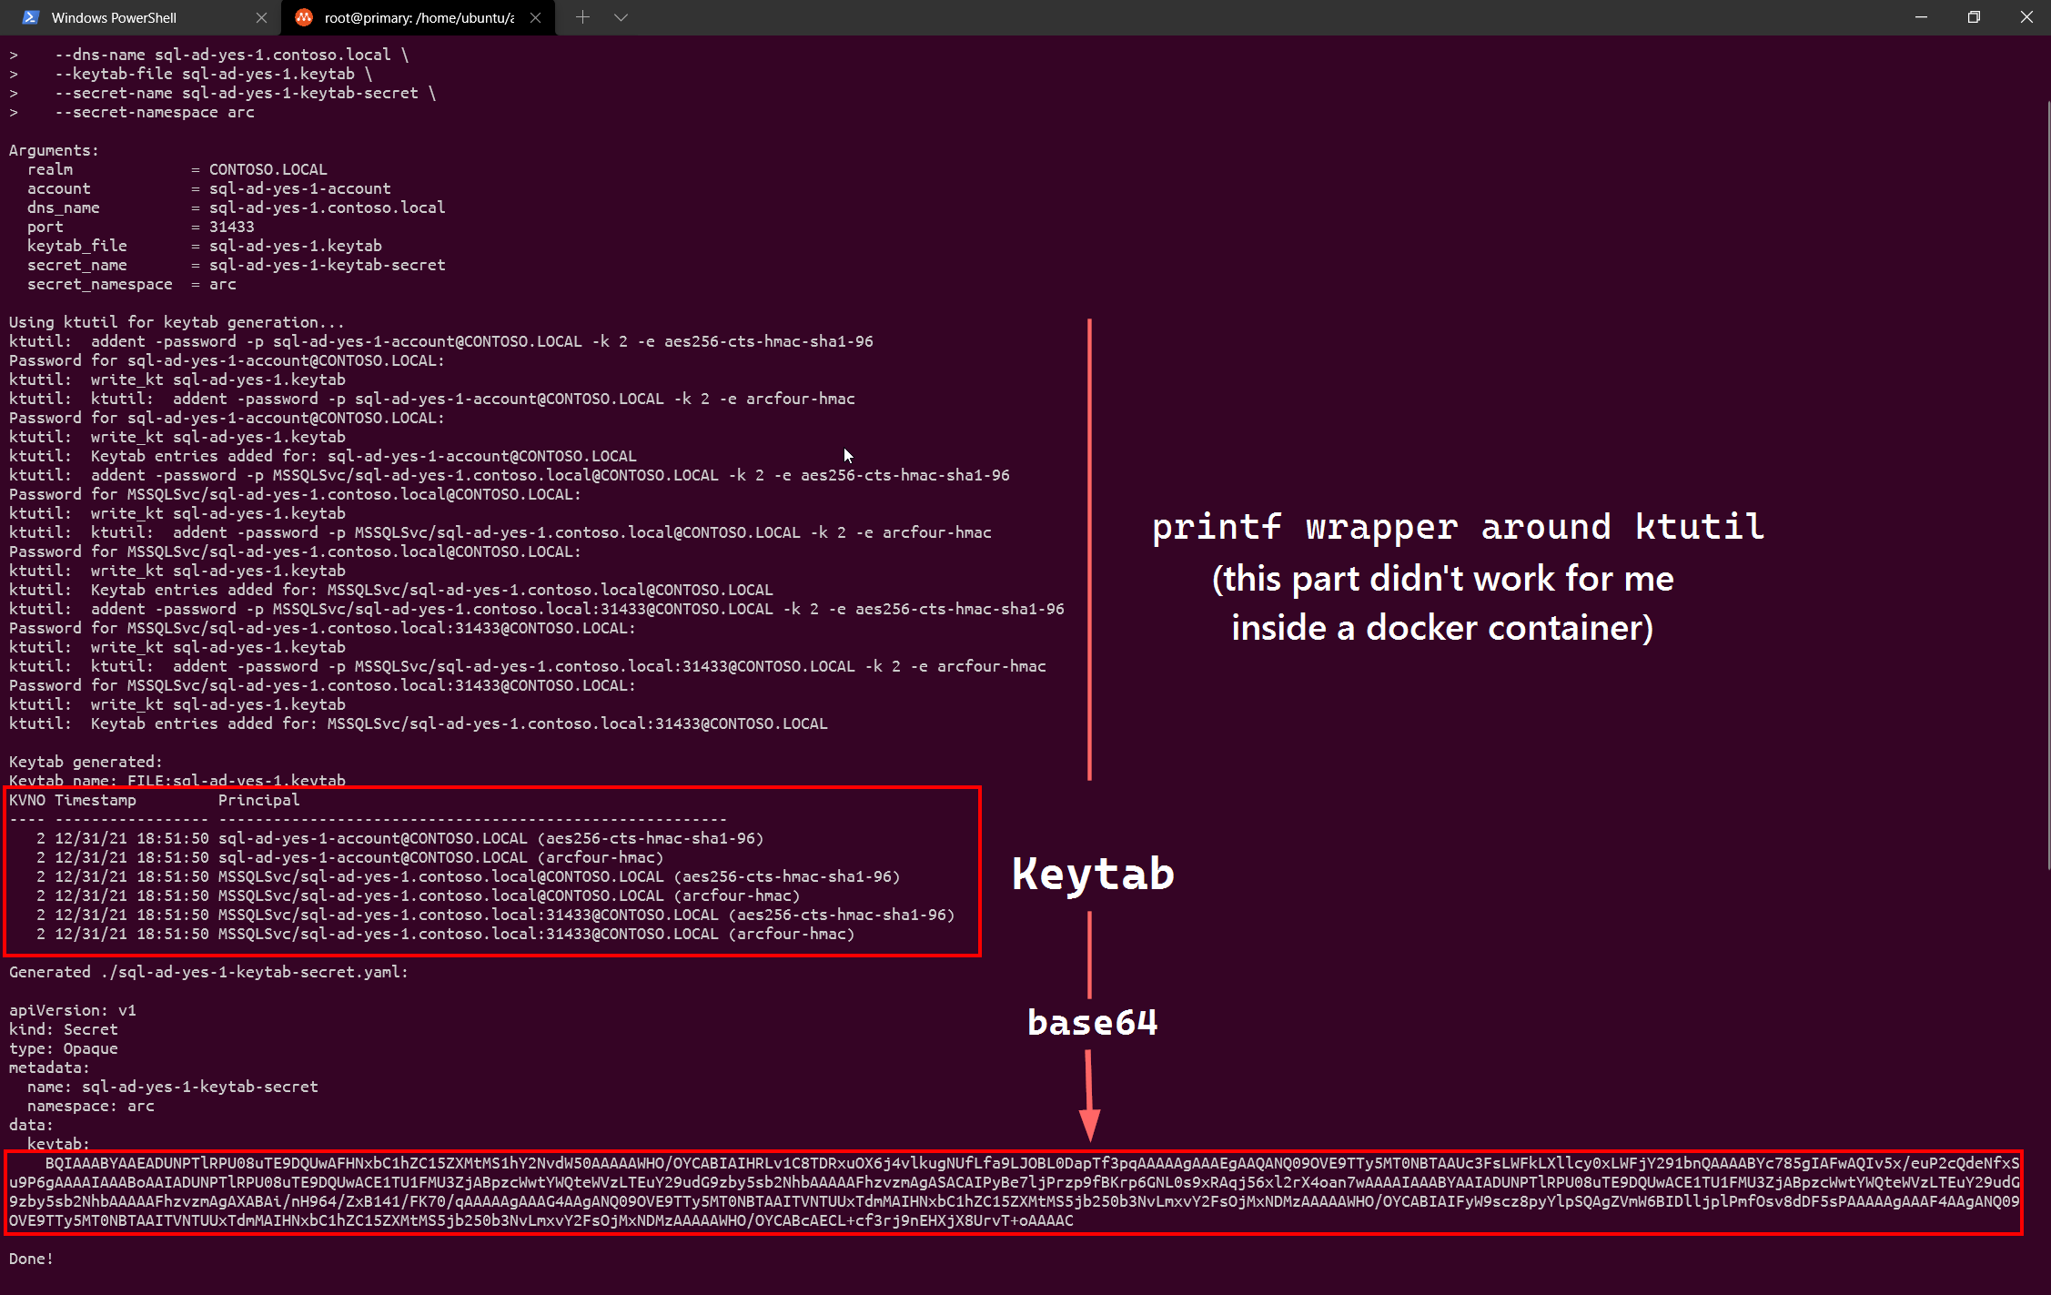

Slide 36
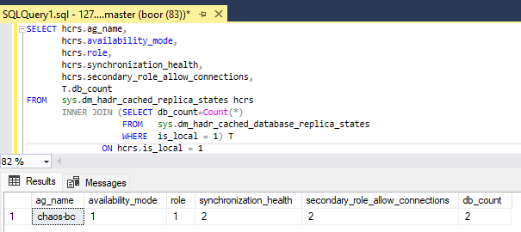
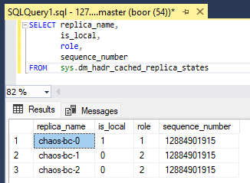
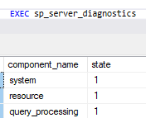



SAMPLE PAYLOADS
agReplicaConfigs
3rd witness for 2 replica deployment
ag_name: "chaos-bc"
replica_name: "chaos-bc-0"
availability_mode: SYNCHRONOUS_COMMIT
replica_role: REPLICA_PRIMARY
is_synchronized: true
is_health_error: false
uid: ""
resource_version: 0
secondary_role_acc: ALL
agRoleMap
fsmState
agConfigEpochMap
{
"PrimaryReplica":"chaos-bc-0",
"RenewLease":true,
"LeaseDuration":30,
"ExternalLeasePollingEnabled":true
}
{
"CurrentPrimary":"chaos-bc-0",
"LeaseDuration":30,
...
"LastFailoverTime":“2022-...",
}
{
"PrimaryReplica":"chaos-bc",
"ReplicaName":"chaos-bc-0",
"ConfigNumber":12884901915
}
Signals for state change
1
Instructing state change
arc-sqlmi
arc-ha-supervisor
3
Heartbeat sp_server_diagnostics
Status updates
sqlserver.exe
Replica 1 of 3
Supervisor
Runs T-SQL for health
2
Client traffic
agReplicaConfigs
Config Map per replica
SIGNALS Primary Candidate for Paxos
Watcher
Pod events etc.
PRIMARY
/var/opt/mssql
Data, data-log, backups…
StatefulSet – SQL Server
Replica 1 of 3
agReplicaConfigs
Latest LSN from Primary
API SERVER
5
Service
Primary
agReplicaConfigs
Supervisor queries DMV for replica states for local instance
6
1
SECONDARY
arc-ha-orchestrator
Supervisor sends sp_server_diagnostics heartbeats to Operator
StatefulSet
Replica 2 of 3
9
Operator
Implements state machine, makes executive decisions
2
agReplicaConfigs
SIGNALS Replica state
Supervisor persists configuration in Replica specific ConfigMap
3
Orchestrator (stateless) reads previously persisted state, uses available signals to perform State Transitions. Primary role, in case of failover, is persisted in Role ConfigMap.
StatefulSet – HA Orchestrator
Replica 1 of 1 (can be up to 3 with leasing mechanism)
Service
Secondary
4
SECONDARY
7
5
StatefulSet
Replica 3 of 3
8
agRoleMap
OPERATIONS AG failover, if needed
6
SIGNALS AG role transitions
7
4
Supervisor reads Role ConfigMap for AG Role Transitions, actions on local replica.
fsmState
Read/Write FSM State
8
Label updates are performed throughout State Transitions
9
ACCESS
DB ENGINES
STATE
OPERATOR

Slide 37



Kill specific containers
Kill entire StatefulSet Pod
6
Prep
Kill Data Controller Pod
COMPUTE CHAOS
Chaos
Burn CPU and RAM
❔
Kill random replica
arc-sqlmi
arc-ha-supervisor
Heartbeat sp_server_diagnostics
sqlserver.exe
Replica 1 of 3
Supervisor
Runs T-SQL for health
Block heartbeat
agReplicaConfigs
Config Map per replica
8
Setup User DB, Table
To test with simulated end-user workloads
Watcher
Pod events etc.
1
Storage latency
Delay reads/writes to /var/opt/mssql/*
/var/opt/mssql
Data, data-log, backups…
6
PRIMARY
agReplicaConfigs
Latest LSN from Primary
API SERVER
StatefulSet – SQL Server
Replica 1 of 3
SIGNALS Primary Candidate for Paxos
Transactions
Continuous INSERTs, from parallel writers
2
Block access to APIServer
Service
Primary
agReplicaConfigs
7
SECONDARY
arc-ha-orchestrator
Force AG Failovers
Force failovers in continuous loops or injections, similar to a malicious end-user/tester
Block access to replicas
StatefulSet
Replica 2 of 3
8
Operator
Implements state machine, makes executive decisions
3
agReplicaConfigs
SIGNALS Replica state
Read User Table
Read access from Secondary, if available
StatefulSet – HA Orchestrator
Replica 1 of 1 (can be up to 3 with leasing mechanism)
Service
Secondary
4
SECONDARY
agRoleMap
StatefulSet
Replica 3 of 3
SIGNALS AG role transitions
OPERATIONS AG failover, if needed
Replica Network failures
Packet corruption, duplicates, delay and loss – to break seeding
5
fsmState
Read/Write FSM State
ACCESS
DB ENGINES
STATE
OPERATOR

Slide 38
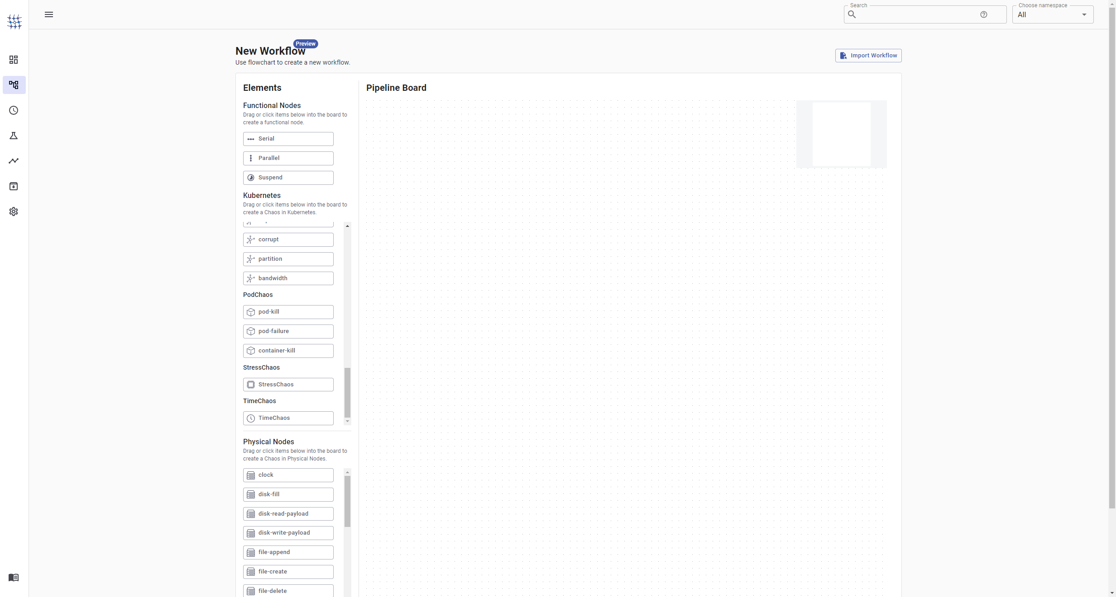
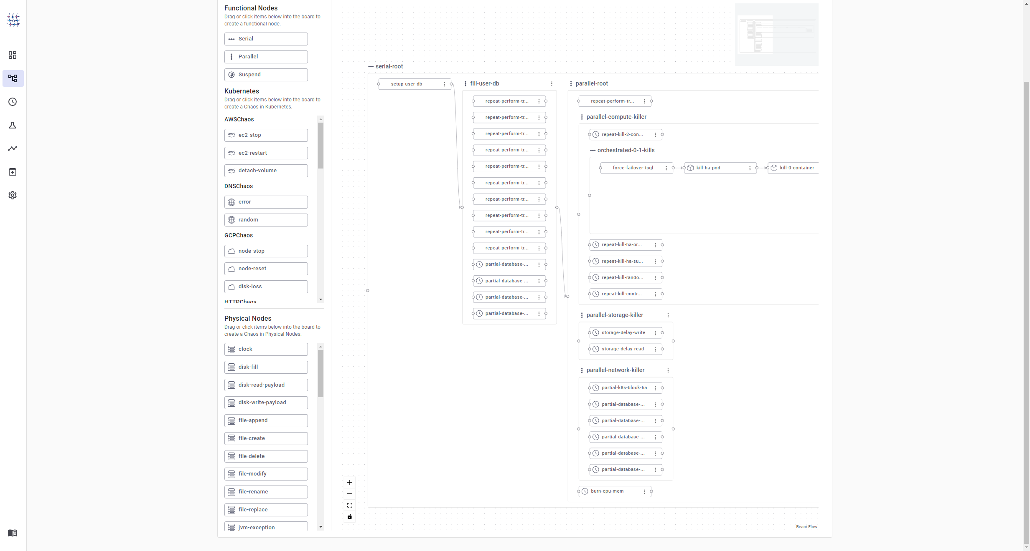
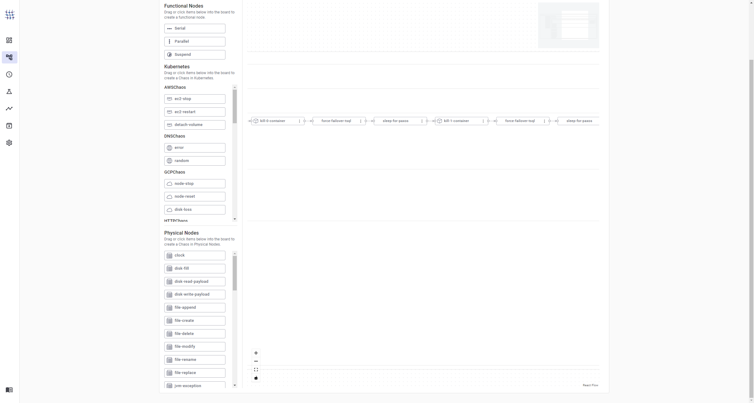
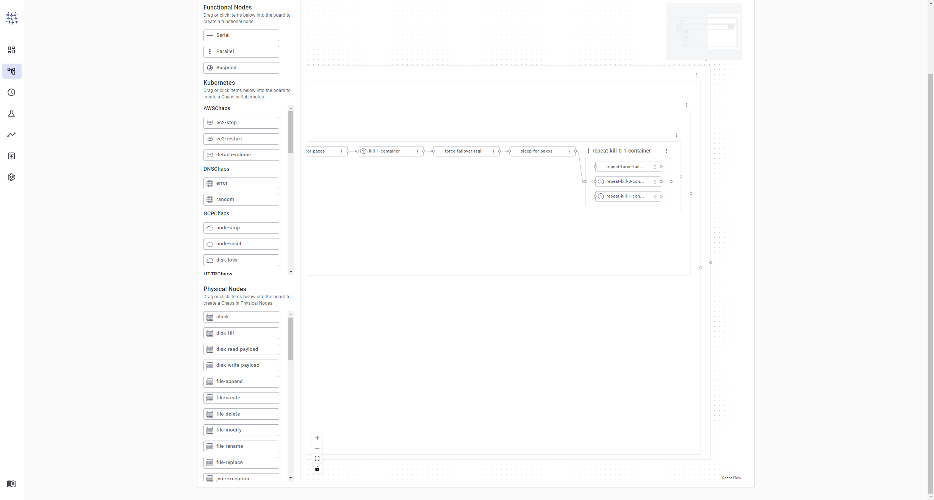
START
END
T = 0 min
T = 18 min
Setup User DB, Table
To test with simulated end-user workloads
Transactions
Continuous INSERTs, from parallel writers
Kill specific containers
Force AG Failovers
Force failovers in continuous loops or injections, similar to a malicious end-user/tester
Transactions
Continuous INSERTs, from parallel writers
An orchestrated set of failures and manual failovers amongst the parallel random kills, to nudge a bad replica (Replica-2) in becoming the Primary, to promote data loss.
Kill specific containers
Kill entire StatefulSet Pod
Kill Data Controller Pod
Replica Network failures
Packet corruption, duplicates, delay and loss – to break seeding
❔
Kill random replica
Burn CPU and RAM

Slide 39





SSL
rakirahman.azureedge.net
SSL
rakirahman.azureedge.net
SSL
rakirahman.azureedge.net
2
Azure Front Door and CDN
Azure Front Door and CDN
2
Azure Front Door and CDN
1
rakirahman.z9.web.core.windows.net
rakirahman.z9.web.core.windows.net
rakirahman.z9.web.core.windows.net
3
You
Azure Storage Account
You
Azure Storage Account
You
Azure Storage Account
rakirahman.me
$web
rakirahman.me
$web
rakirahman.me
$web
Blob Container
1
Blob Container
Blob Container
CI/CD
CI/CD
CI/CD
4
main.yaml
main.yaml
main.yaml
GitHub Workflows
GitHub Workflows
GitHub Workflows
1. gatsby build
1. gatsby build
1. gatsby build
Compile static website
Compile static website
Compile static website
2. az storage blob upload-batch
2. az storage blob upload-batch
2. az storage blob upload-batch
Upload to Blob
Upload to Blob
Upload to Blob
3. az cdn endpoint purge
3. az cdn endpoint purge
3. az cdn endpoint purge
Me
Purge CDN cache
Purge CDN cache
Purge CDN cache
git push origin master (YOLO)
Me
Me
git push origin master (YOLO)
git push origin master (YOLO)
SSL
rakirahman.azureedge.net
SSL
rakirahman.azureedge.net
Azure Front Door and CDN
Azure Front Door and CDN
rakirahman.z9.web.core.windows.net
rakirahman.z9.web.core.windows.net
You
3
Azure Storage Account
You
Azure Storage Account
rakirahman.me
$web
rakirahman.me
$web
Blob Container
Blob Container
CI/CD
CI/CD
main.yaml
main.yaml
GitHub Workflows
4
GitHub Workflows
1. gatsby build
1. gatsby build
Compile static website
Compile static website
2. az storage blob upload-batch
2. az storage blob upload-batch
Upload to Blob
Upload to Blob
3. az cdn endpoint purge
3. az cdn endpoint purge
Me
Purge CDN cache
Purge CDN cache
git push origin master (YOLO)
Me
git push origin master (YOLO)

Slide 40









Any Spark Session Provider
Any App Hosting Provider
Including docker on your laptop
Including docker on your laptop
A Spark Cluster
4
An OpenTelemetry Collector Deployment
OTLP
6
Driver Process
JVM, Malloc
5
Collector Process
Metrics
your.main.class
1
spark-submit
--conf spark.plugins=your.plugin.class
--class your.main.class
Does Spark DataFrame calculation stuff
your.plugin.class
Background Thread
HTTP Receiver
Exporter (Batched)
Does literally anything you want
Processor
2
3
2
7
Streaming APPENDs
Executor
. . .
OneLake
Or any other Cheap Storage Provider
(As many nodes as you like)
8
Power BI
3
BYO-favorite DirectQuery engine

Slide 41






Your CICD Provider
GitHub Actions, Azure DevOps etc.
Your CICD deployment code
JWT
Service Principal or
Managed Identity
HTTPS
Entra
SPN blocked
Workspace Stuff
Your regular laptop
IT approved and onboarded
Various APIs
Human allowed
Your CICD deployment code
JWT
You Human being
HTTPS
Entra

Slide 42

Your CICD Provider
GitHub Actions, Azure DevOps etc.
Your CICD deployment code
JWT
Service Principal or
Managed Identity
HTTPS
Entra
2
Azure Relay Sender
7
“Human” allowed
Workspace Stuff
1
Various APIs
1z
Azure Relay
3
Azure Relay Listener
Your regular laptop
IT approved and onboarded
JWT
You logged into Entra on your laptop
A bunch more laptops or Cloud Devboxes for High Availability Init script to start listening after reboot
Entra
Credential Bridge
6
4
5
Azure Relay Bridge

Slide 43

IT SUPPORT
YOUR Manager
THE PERSON WHO CAN CLICK THE BUTTON
YOU
HEAD OF DATA
SECURITY TEAM
ENTRA ADMIN

Slide 44
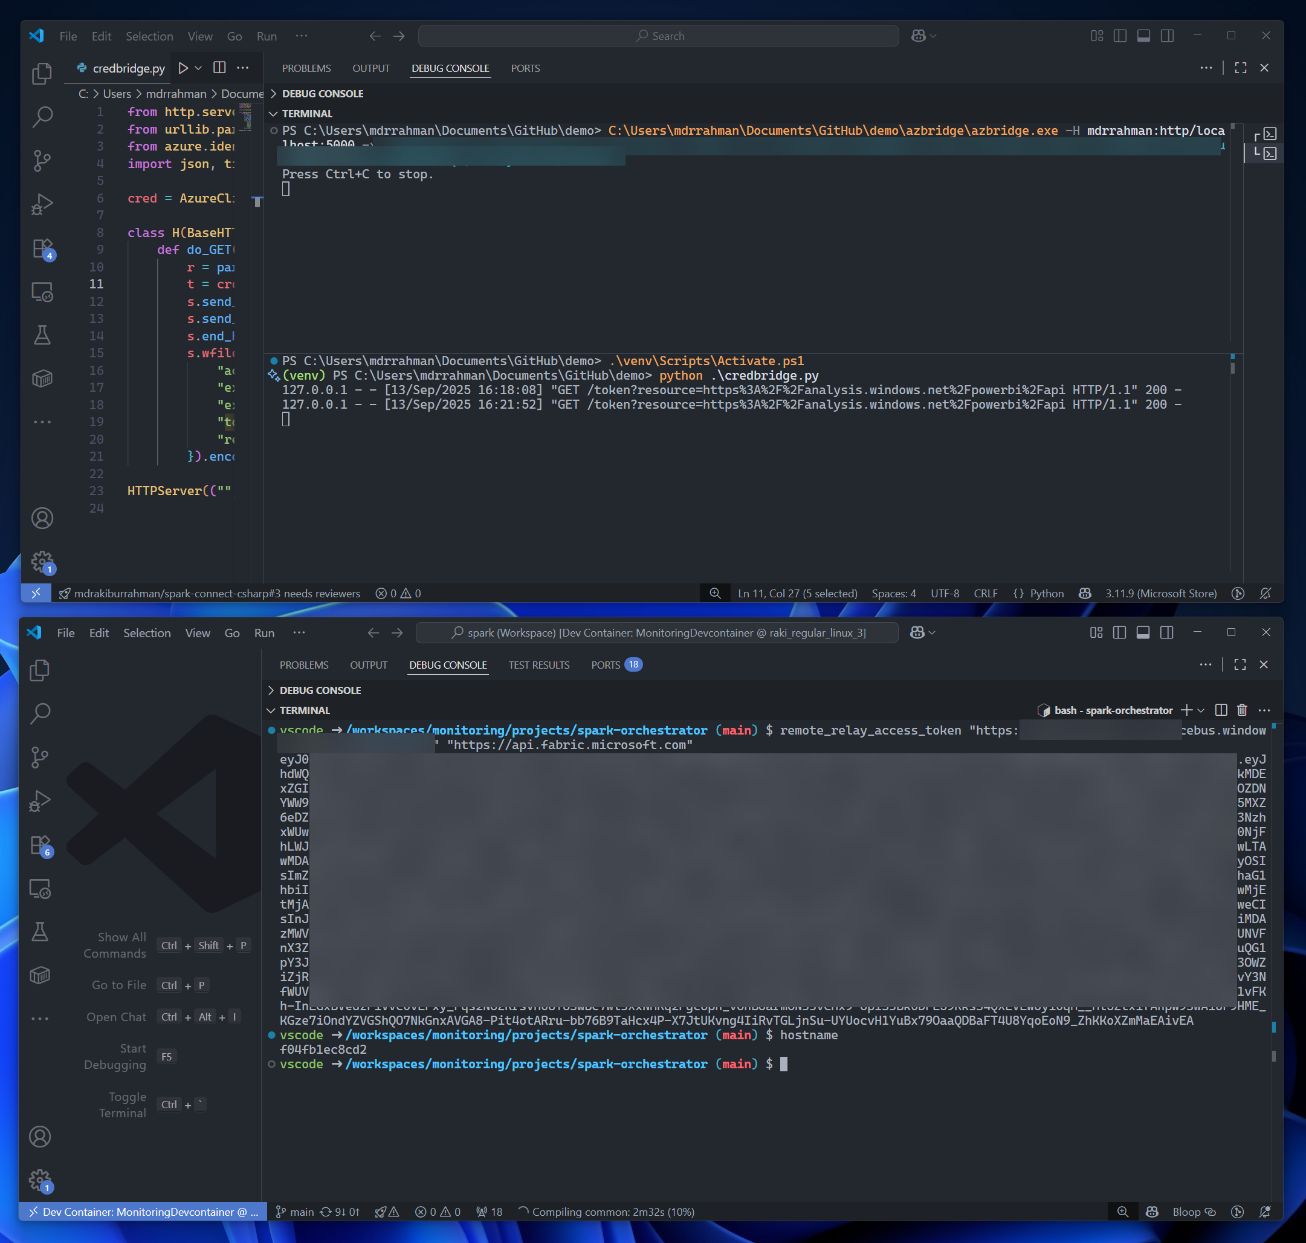
azbridge
Maps port 5000 from your machine to Relay port 443
credbridge
A simple API on port 5000
CICD infra
Some machine with SPN/ Managed Identity

Slide 45
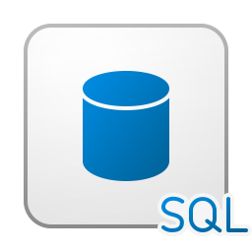
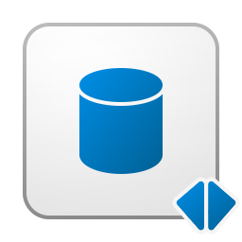







F2
4
v
Files / LandingZone / foo.schema / table
Tables / foo / table
3
🔥
Benchmarker App
_change_data
_FilesReadyToDelete
_delta_log
2
metadata.json
_index_bin
Multiple-threads
Duck DB Parquet
…parquet
deletion_vector.bin
1
part-000..parquet
COMPUTE
Courtesy of Fabric
STORAGE
Courtesy of OneLake (Up to FX Terabytes, then you pay)

Slide 46

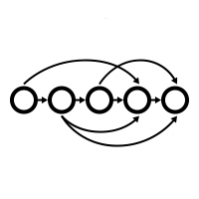


Any Spark Session Provider
Including docker on your laptop
OneLake
Driver Process
2
7
Main App
3
Driver Plugin
JSON
1
END
spark-submit
--conf spark.plugins=your.plugin.class
--class your.main.class
5
ETL DAG
6
HTTP /flush
Buffer
RPC Receiver
10
8
Marquez
Executor
2
Docker
Script
Spark Listener
4
Executor Plugin
JSON
JSON
9
(Not our code)
HTTP /api..
RPC Client

Slide 47






Census
sqlmesh
SDF
dbt

Slide 48
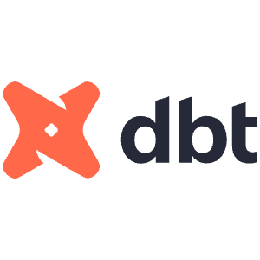










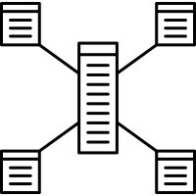

Minimize the amount of code here! Try to replace this with Spark Declarative Pipelines Streaming Tables as soon as you get your hands on Spark 4.2 and throw Copilot at it.
2
3
Data/Software Engineers (me) writing fancy Stream Prcessing code in a non-standard manner AI can struggle to fully grok.
Analyst/PM talking to Copilot with dbt constructs that AI understands very well.
Data Warehouse
Data Mart
1
Data Quality
Referential Integrity
Ingest as cheaply and as fast as possible
Spark Streaming
Weird funky data sources and APIs
(incremental, stateful, idempotent)
BRONZE
Stable well-known static schemas
SILVER
Schematized Tables
GOLD
Kimball SCD2,
with trx-grain
GOLD
Pre-aggregated, Periodic Snapshots
Schema on read
Schematized tables
SCD2, Trx-grain STAR Schema
Periodic Snapshot STAR Schema
Dump into Delta Tables with minimum schema assumptions. No transformations.
Fully exploded columns with minimal nesting and maximum columnar compression. Tables are wide and tall, not suitable for JOINs.
A strict, Kimball STAR Schema with Slowly Changing 2 Dimensions. Transaction-grain, high-cardinality.
Kimball Periodic Snapshot STAR Schema with daily/weekly/monthly snapshots, highly-tuned for query performance, reduced-cardinality.

Slide 49







1
9
Data Warehouse
Data Mart
We can test this locally similarly too
Spark Streaming
Dbt + Lakehouse
Data Quality
Referential Integrity
OneLake
Business Value
BRONZE
Stable well-known static schemas
SILVER
Schematized Tables
8
GOLD
Kimball SCD2,
with trx-grain
GOLD
Pre-aggregated, Periodic Snapshots
5
Merge to main Push with fabric-cicd
blobfuse read-only
The exact same VSCode Devcontainer
Local Spark
CI Spark
Docker on your laptop
CI machine with Docker
Driver Process
/tmp/mnt/onelake
7
2
Lakehouse mock
Fabric Livy mock
To enable parallel dbt buids, the default Derby Spark ships with is single reader, single writer, a huge testing bottleneck
SILVER
Schematized Tables
Github Actions
SQL Server on docker
Hive API
Livy Server
“Delegate, delegate, DELEGATE!”
Integrated Development Environment
Local HDD
3
6
Spec Kit
Copilot CLI plan mode
Agent Skills
Ralph Loop
VS Code
Declarative ETL
10
GOLD
Various tables
Azure DevOps Pipelines
4
Vibe coding
“Sir, YES SIR!”
Rapidly parallelize/tear-down with GitHub Copilot CLI/Claude Code etc

Slide 50
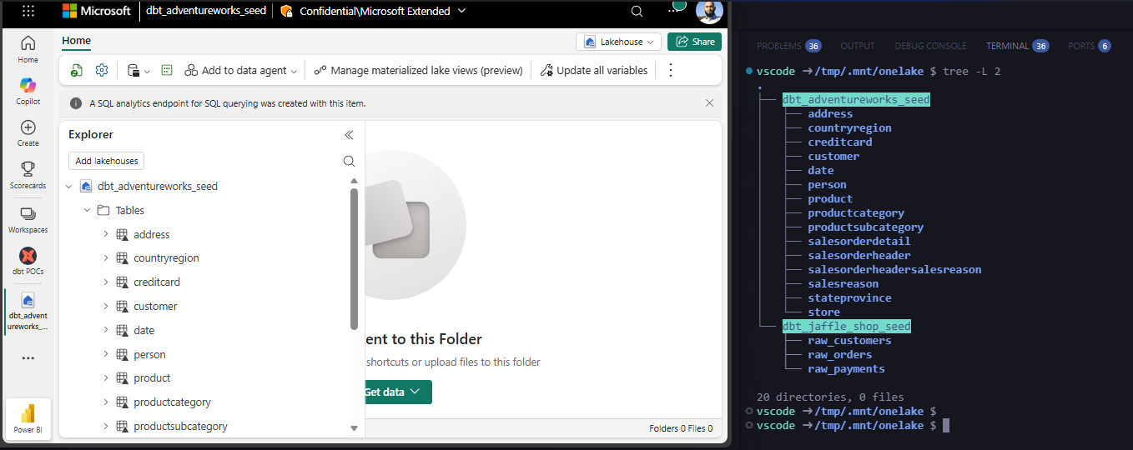

Mounting OneLake locally in VSCode Devcontainer via blobfuse and az CLI

Slide 51
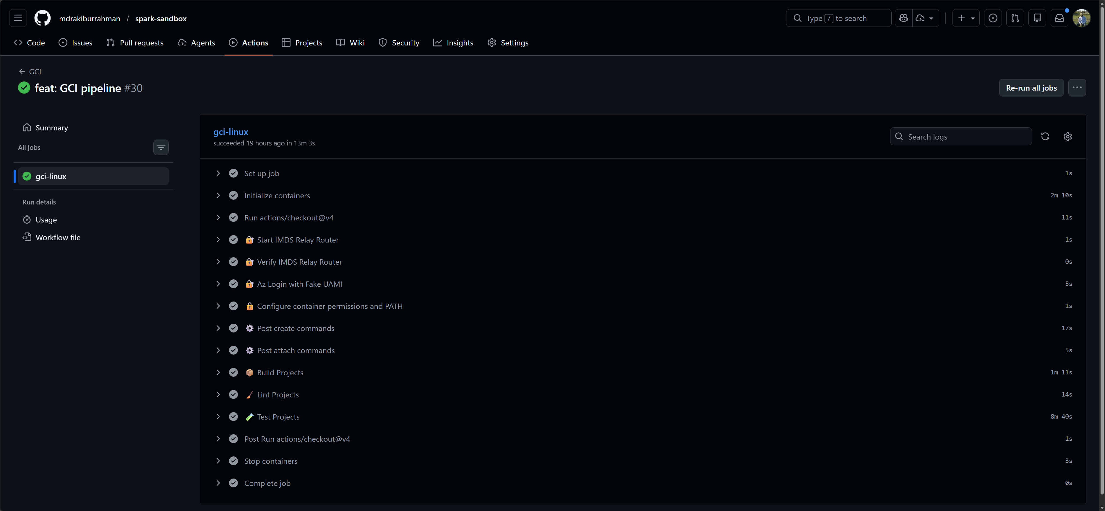
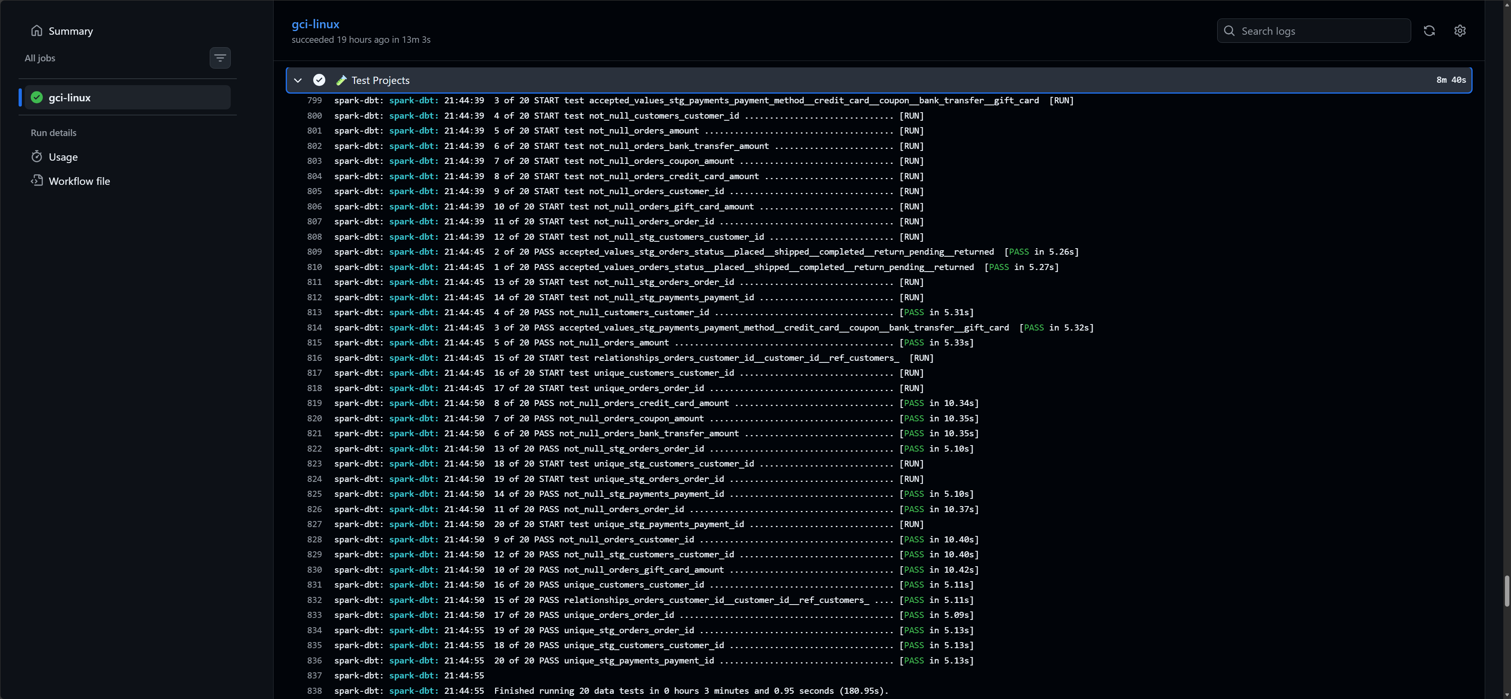


Ripping through dbt tests in GitHub Actions by mounting OneLake with blobfuse

Slide 52
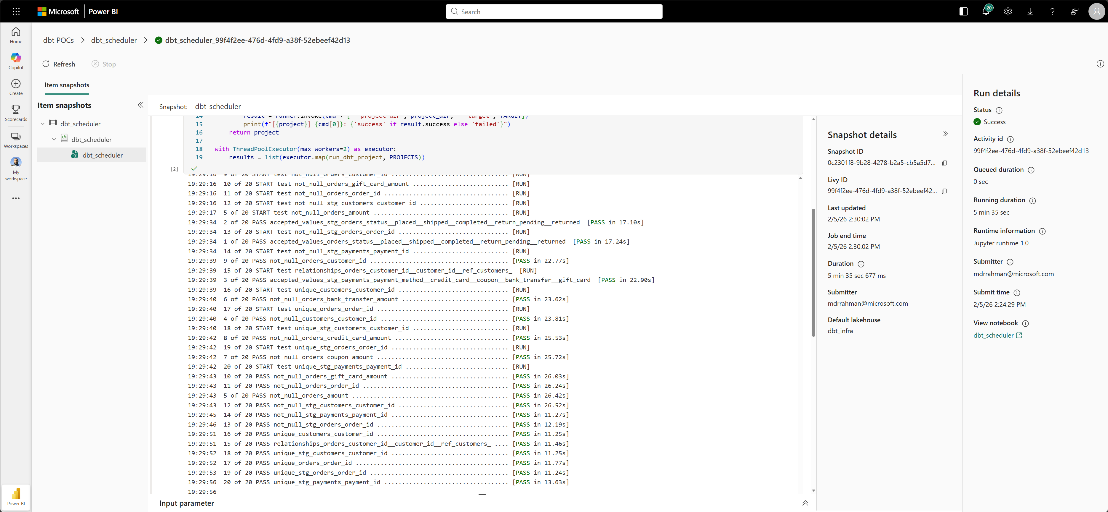


Ripping through dbt model against Fabric Spark Environment with a large Cluster after PR merges to main
2-core cheap Python Notebook
World’s simplest Data Factory pipeline to wrap dbt

Slide 53



Lakehouse AKA Spark
Warehouse AKA Serverless SQL Server
OPTION 1: Fabric/Local Spark with OneLake RBAC and read-only mount across Workspaces
OPTION 2: Use a single Fabric Worskpace and a single Warehouse for dev/test/prod
Fabric Warehouse
Single warehouse for dev/test/prod
Spark Streaming
prod
my-dev-schema
ci-test-schema-20260…
BRONZE
Stable well-known static schemas
OneLake
SILVER
Schematized Tables
Production
Dev/Test
COPY 🤮
Local/Fabric Spark
Fabric Warehouse
Can mount tables from anywhere and expose it as native tables
Read-only access to Production
Cannot mount tables from anywhere and expose it as native tables
Declarative ETL
Metastore
Hive API
Write locally or dev workspace
Must copy data via CTAS every time you want to refresh and expose data as silver.table_in_onelake to dbt.
If you have 1000 source tables in your dbt, good luck 🙂
CREATE TABLE IF NOT EXISTS silver.table_in_onelake USING DELTA
LOCATION abfss://onelake.dfs.fabric.microsoft.com/…/
Core differentiating feature in Lakehouse/OSS Spark for maximum flexibility

Slide 54

















Local machine
Spark Streaming
Contains large git repositories and Windows Login context
copilot –acp –port 8080
Highly flexible rules engine
😩 Pain
11
12
2
10
TFIDF
Soundex
Agglomerative Clustering
Git blame
ODBC/Jupyter Kernel
Static RegEx rules
1
14
9
Lakehouse
SQL EP
Deterministic
Non-deterministic
Fabric
Flaky incident reassignment to original authors or their managers
with evidence of ownership
Deterministic, desired state, data driven, tested code that works with my JWT
Observed
impersonation
JWT
7
100s of incidents
😩 Pain
🤖
5
Synthetics
4
Best guess
3
Me
Sniff network trace to extract JWT
6
/plan
/research
/fleet
/autopilot
13
Livesite Incident Management System
Gigabytes of git history across several git repos
Many git repos
Playwright MCP to click around the UI to figure out all the undocumented API calls
8
Index, lemmatize, tokenize
Git provider
Inspired by OpenClaw, but significantly more deterministic and safer

Slide 55

Incidents that are mostly similar, but cannot be bucketed without human intervention, RegEx or NLP

Slide 56

Bucketing allows us to significantly reduce the volume of unique incidents that can be batch assigned with high confidence. The more incidents you have open, the more effective the bucketing is.

Slide 57

Incident Buckets
Incident owners
Bucket heatmap

Slide 58



Super flaky incidents
Incident buckets
Actual outages
Incident owners determined via ML

